Slide 1
Microservice Application Platforms
Pravin Y Pawar

Slide 2
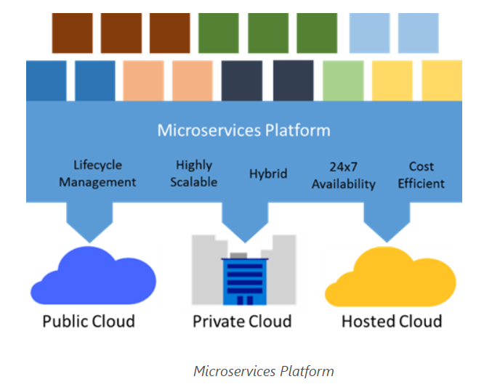
Microservice application platforms
Source : Microsoft

Slide 3
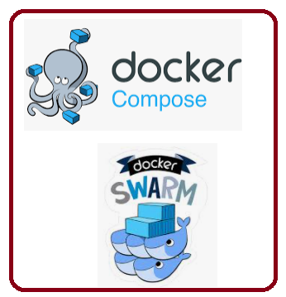
Microservice application platforms
Docker Swarm and Docker Compose
Natural fit with microservices architectures
Standard packaging format and resource isolation of Docker containers
Docker Compose
defines an application model that supports multiple Docker-packaged microservices
Docker Swarm
serves as a cluster manager across a set of infrastructure
exposes the same protocol that a single-node Docker installation does
easily works with the broad Docker tooling ecosystem

Slide 4
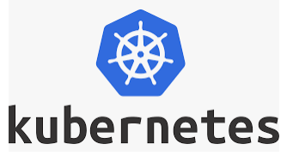
Microservice application platforms
Kubernetes
Developed by Google - based on experience in Search and Gmail
Open-source system for
automating deployment
operations
scaling of containerized applications
Groups containers that make up an application into logical units for easy management and discovery
Even some traditional PaaS solutions are merging with Kubernetes, like Apprenda

Slide 5
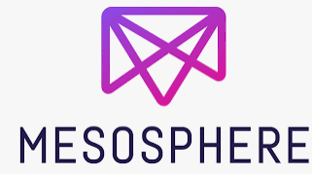
Microservice application platforms
Mesosphere DCOS, with Apache Mesos and Marathon
Mesosphere Datacenter Operating System (DCOS), powered by Mesos
is a scalable cluster manager that includes Mesosphere’s Marathon, a production-grade container orchestration tool
Provides microservices platform capabilities including
service discovery
load-balancing
health-checks
placement constraints
metrics aggregation
Offers a library of certified services can all be installed with a single command
Kafka
Chronos
Cassandra
Spark
Microsoft and Mesosphere have partnered to bring open source components of the Mesosphere Datacenter Operating System (DCOS)
including Apache Mesos and Marathon, to Azure

Slide 6

Microservice application platforms
OpenShift
Backed by Red Hat
Platform-as-a-service offering that leverages Docker container-based packaging for
deploying container orchestration and compute management capabilities for Kubernetes
enabling users to run containerized JBoss Middleware
multiple programming languages, databases and other application runtimes
OpenShift Enterprise offers a devops experience
enables developers to automate the application build and deployment process within a secure, enterprise-grade application infrastructure

Slide 7
Thank You!
In our next session:

